Slide 1
Automation for Network Lab Enviroments

Slide 2
Who Am I?
Tobias Heister
Solutions Architect
Technical Pre-Sales
Vendor MGMT for Focus Vendors
Solutions Engineering and Partner Evaluation
XT3LAB
3y Deutsche Telekom – Carrier and DC
8y Host Europe - Hosting Provider, Network centric Roles (Engineering, Managed Services)
3y Xantaro – Professional Services for 1y then SOLAR

Slide 3
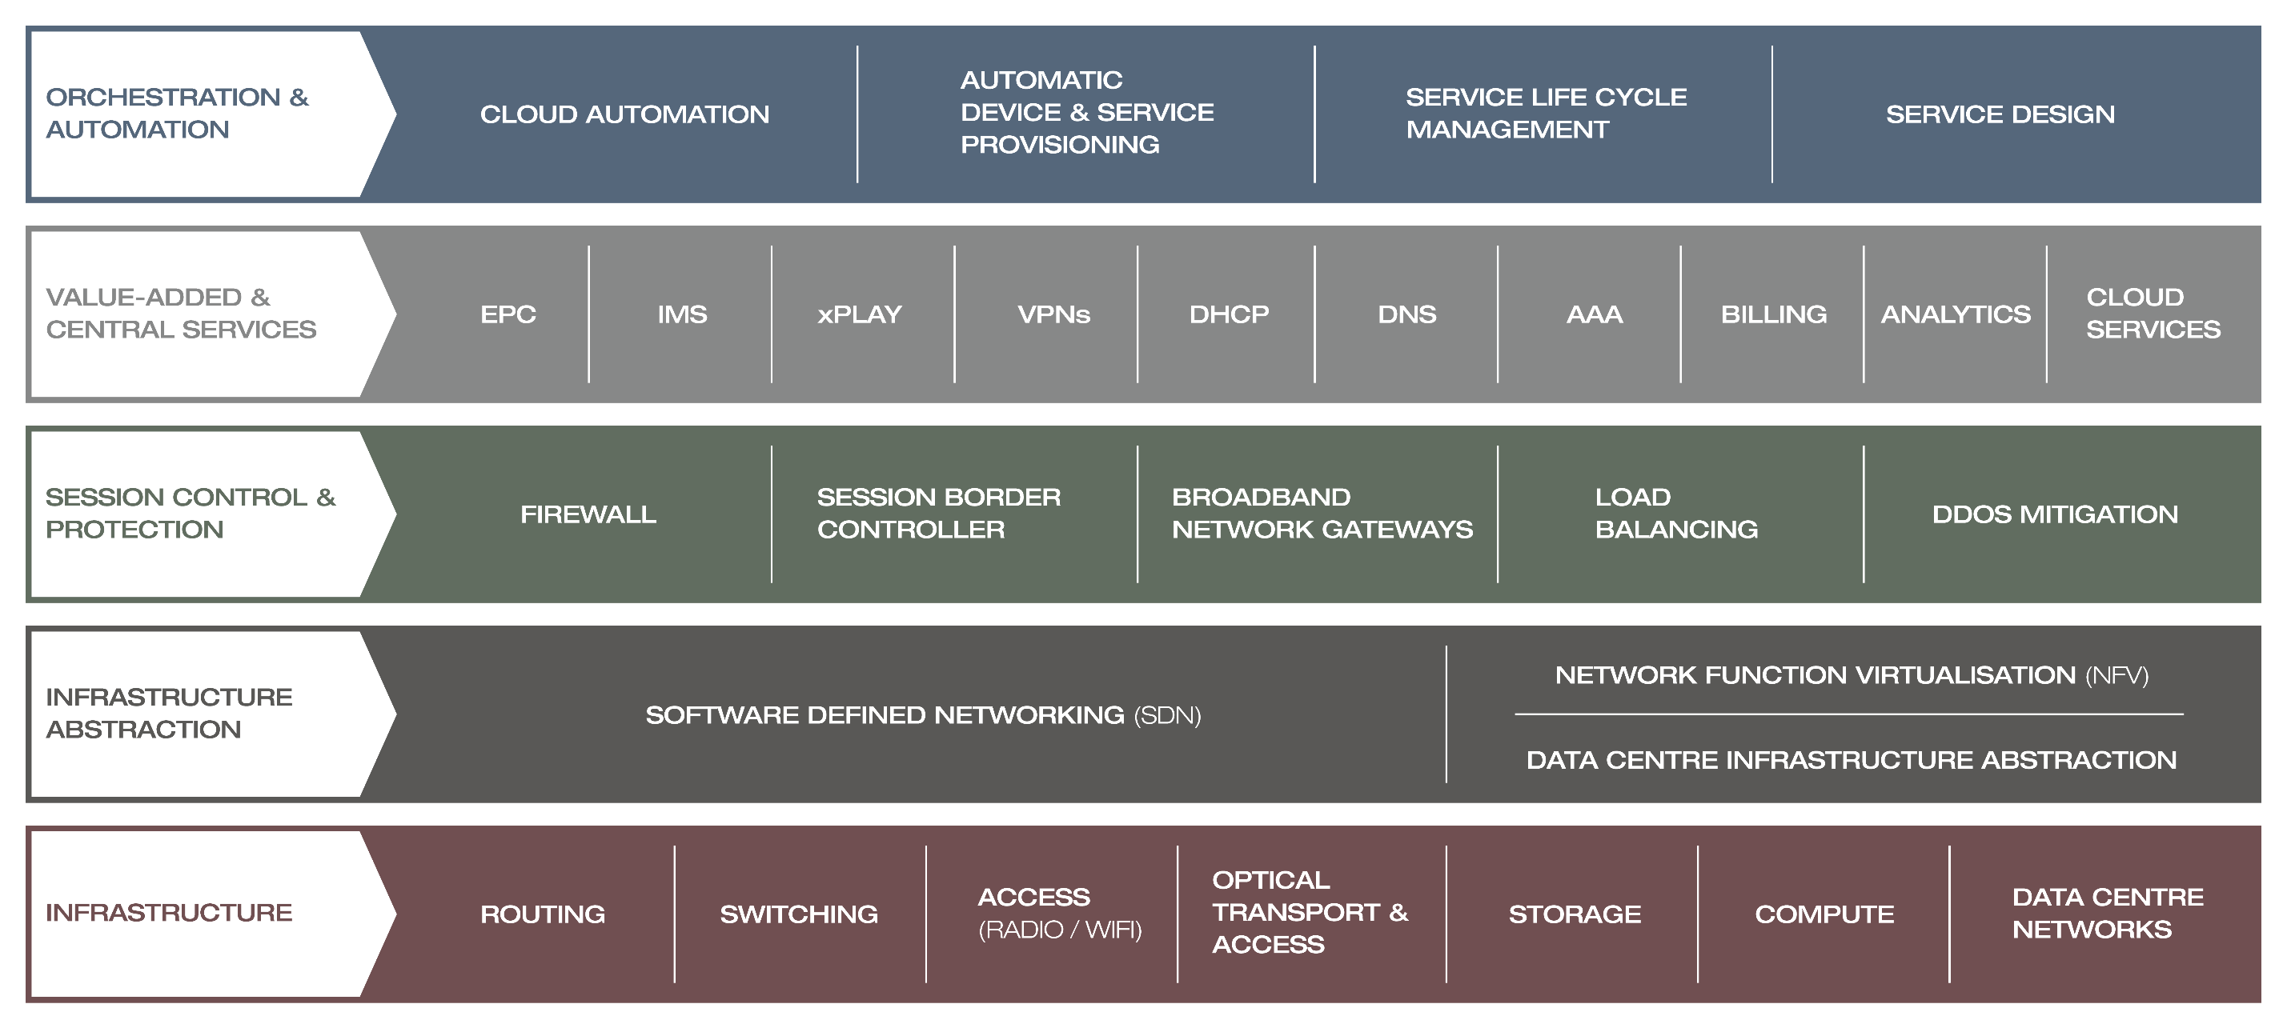
OUR TECHNOLOGY SOLUTIONS – Covering All Network Layers

Slide 4
Why do we have a XT3LAB?
Technology
Testing
Training
Technology across all layers:
Services
Security
IP/MPLS
Wireless Transmission
Optical Transmission
Looking beyond the datasheet:
Test of single components
Proof-of-Concept tests
Designtests
Regressiontesting of new OS Versions
Knowledge-Transfer:
Standard – and custom trainings
Workshops
Bootcamps
On-site or remote
Internal or external

Slide 5
XT3LAB Facts
10 Racks
Hard/Software
Multiple vendors
All OSI Layers
IXIA
100G/40G/10G/1G
Thousands of ports
Hundreds of connections
Should be useable for everyone
Customers
Colleagues
Vendors

Slide 6
XT3LAB Infrastructure
10 Racks with each
Terminal/Console Server
ooB Switch for MGMT Ports and Connectivity
XT3LAB Fabric (Juniper Virtual Chassis) for flexible connections
Manageable/Switchable Power Outlets (PDU)
Firewall and VPN Gateway
Hundreds of Ports and >40 devices to manage for Infrastructure alone

Slide 7
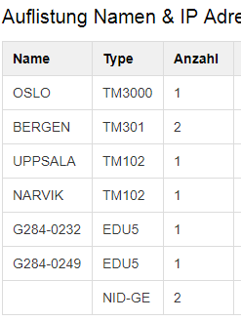
The Past
We used the Industry Standard MGMT Tool - Excel
Tried a Wiki based system
Every Lab user had direct login for the power bars
Switch on/off Lab devices as needed
If you needed a console, consult documentation, note IP and port and connect
At one point in time we introduced scripts
Create aliases for Switching outlets
Create aliases for console ports (telnet xyz)
Create aliases for MGMT Connectivity (ssh xyz)
All manually maintained, never recent always out of date!
We need something better!

Slide 8
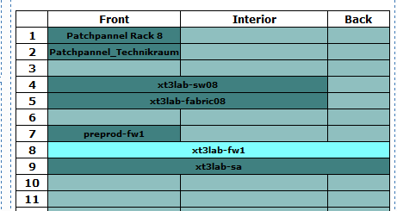
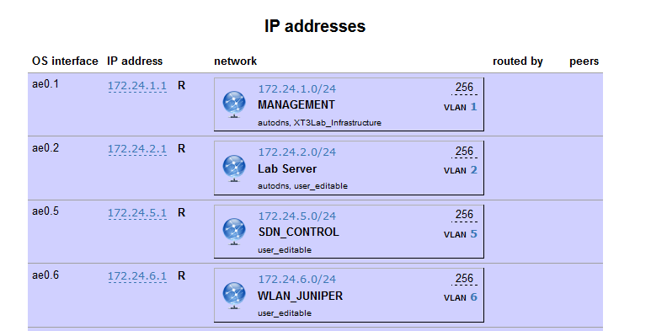
Step1: Documentation System – Racktables

Slide 9
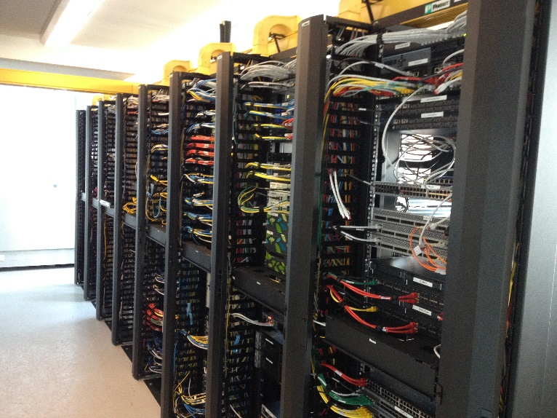
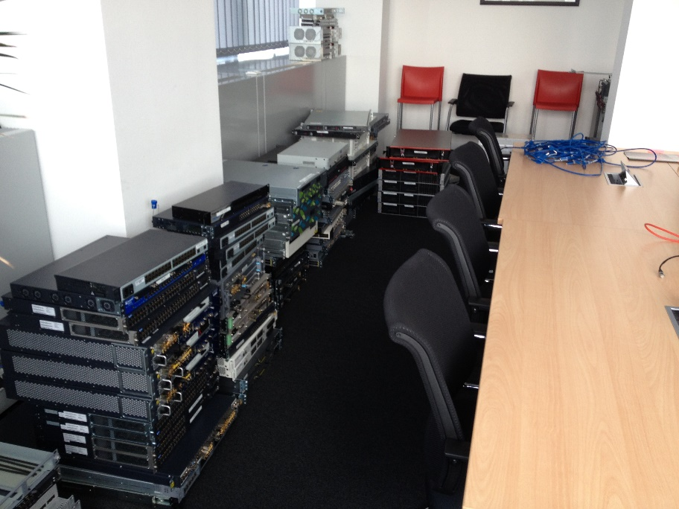
Problem solved?
Not yet! Scripts still maintained manually
Sometimes you need external Motivation
News came in around September 2015: We need to move the LAB in 2016!
Lazy Admin incoming
Nobody wants to reconfigure all of theses switches and terminal servers
Automation to the rescue!
We have a couple of month left, so lets go!

Slide 10
Step 2 – Automate Basic Tasks
There is/was no native (useable) API in Racktables ☹
There are some stale APIs on github which we tried to quickly adopt (https://github.com/xing/racktables_api https://github.com/stemid/racktables-api)
For now some of our scripts use the XING API, some are directly querying SQL (ugly but works)
What do we do so far
Create console and MGMT Access shell aliases
Create power on/off shell aliases
If multiple outlets are used -> single alias
Configure ooB Switches
Change Port Description
Assign vlan
Configure XT3LAB Fabric Switches
Change Port Description (vlan is set manually by users in order to make virtual cross connects)

Slide 11
Step 2 – Automate Basic Tasks
What do we do so far (continued)
Configure Console/Serial Server
Change Port Description
Configured PDUs
Change Port Description
Mostly API/SQL Consumption and creation of Include Files + direct Interaction with devices

Slide 12
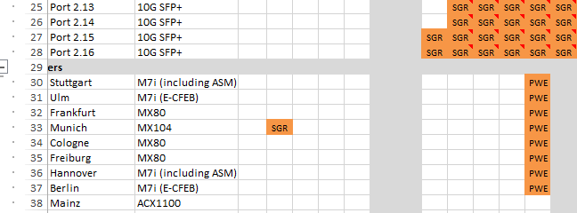
Step 2 – Booking Resources
What is even better than using Excel for MGMT? Multi User Excel!
At first Excel file shared via Sharepoint
Later Excel File shared via SMB + Multi User
We need something better!

Slide 13
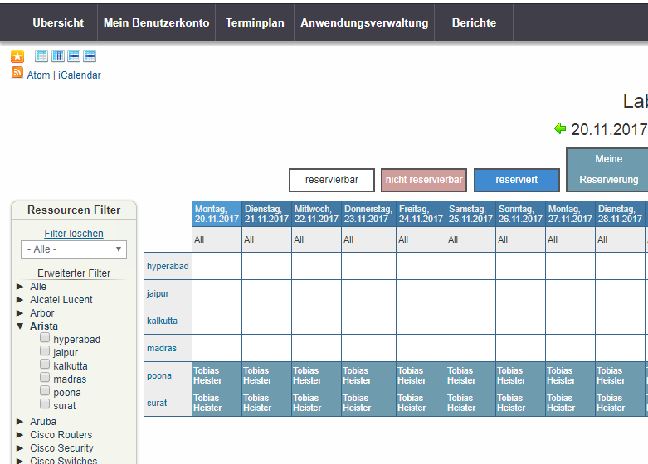
Step 2 – Booking Resources
Booked (http://www.bookedscheduler.com/)
Web based scheduling tool
Once Again no API ☹ but at least simple DB
What we do today
Attach specific Tags to device in Racktables -> booked
Booked has options to
Resolve booking conflicts
Share Bookings between users
Create Reports to identify high/low demand devices

Slide 14
Step 3 – First Benefits of automation
We now know Which devices are present and Who uses them
In the past devices were often powered on but not used (forgotten/ignored to power off)
In the past we had a cron job to notify the Lab Managers about devices still powered on -> manual power off
Now we power off all devices not booked every 15min!
Attach specific Tag to device in Racktables -> eligible for auto power off
Attach specific Tag to device in Racktables -> chooses which power off method to use (graceful vs. Poweroff)
Enforce booking Quota per User, before users sometimes booked half of the lab but used nothing
Special Users for Booking large chunks of hardware (e.g. trainings)

Slide 15
Step 4 – Monitoring the XT3LAB
How much Power does the Lab consume? Does it help to power down devices?
How are the environment parameters?
We use librenms as an autodiscovery tool to identify and poll the metrics of our XT3LAB infrastructure devices (https://www.librenms.org/)
It scales well enough for the amount of devices and metrics
It is “easy” to extend for new devices and metrics
It has an nice, open and responsive community and is actively being developed
We rarely use the librenms Web UI or look at the RRD Files generated
We use librenms to write into influxdb in parallel to creating its RRD Files
We use grafana to display the information we need

Slide 16
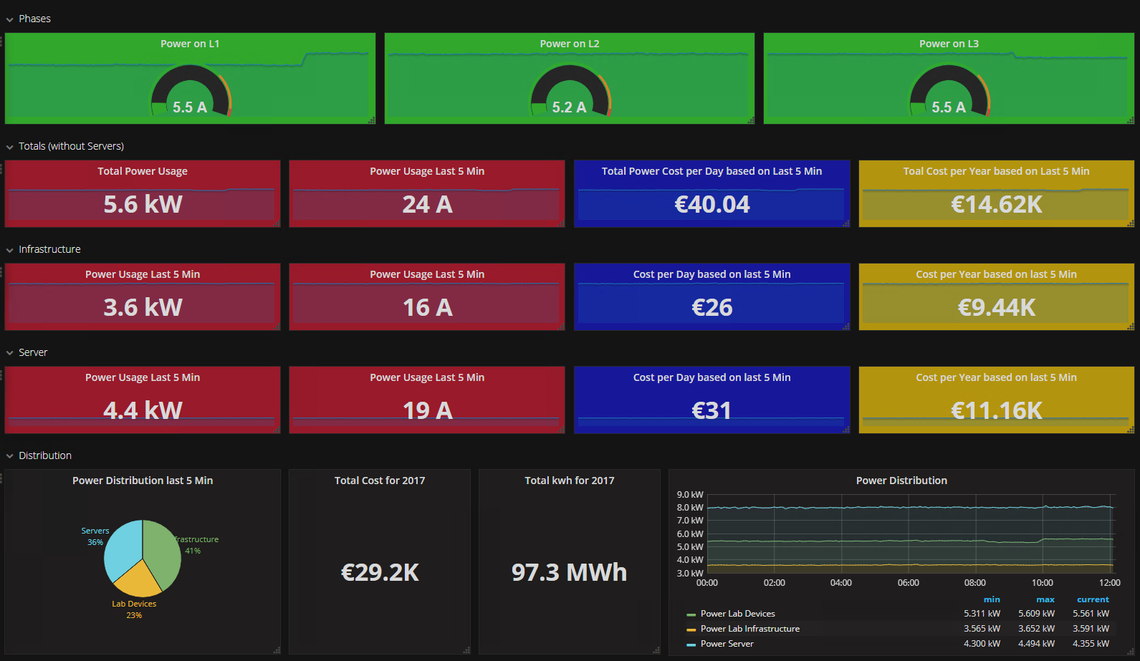
Step 4 – Monitoring the XT3LAB

Slide 17
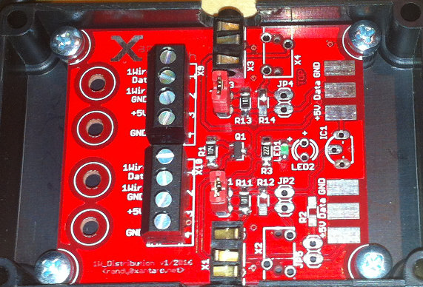
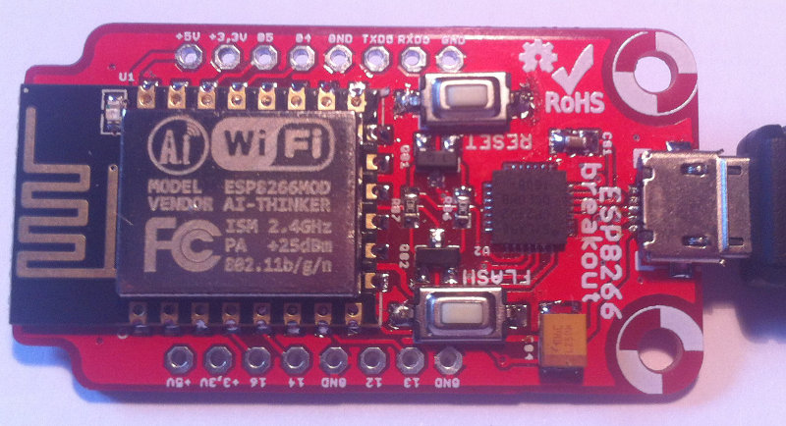
Step 4 – Monitoring the XT3LAB
Temperature and Humidity can be monitored via sensors attached to the PDUs we use
Theses Sensors are quite expensive
One of our colleagues designed a small solution to connect multiple oneWire Sensors to a Raspberry Pi
Circuit board to aggregate a number of sensors + Interface for the Pi + Some Connectors and a bit of wiring
Send the circuit plans to China and receive nice boards
We now have temperature sensors for each rack (one in the front and one in the back)
Humidity and Wireless Temperature sensors (e.g. to place near AC outlets) will follow soon

Slide 18
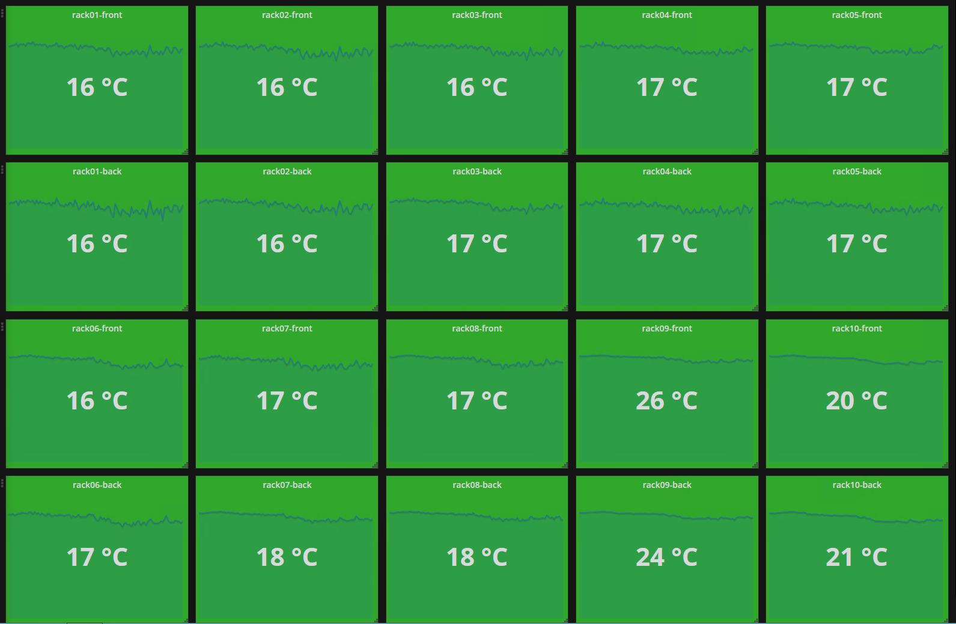
Step 4 – Monitoring the XT3LAB

Slide 19
Step 5 – Miscellaneous
Single source for Authentication
Users are created on Linux Jump Host
freeradius uses local user DB and is used by
VPN Gateway
Fabric and ooB Switches (read/write)
Firewall (read)
User Database is synced automatically to
Librenms
Booked
Racktables
VMware vcenter (Linux vcenter Appliance)

Slide 20
Step 5 – Miscellaneous
DNS
For all IP networks in Racktables that have a specific Tag attached we create
DNS Reverse Entries
DNS Records for the Hostname listed in a specific field of the IP Address
There are some sanity checks and whitelisted domains to do the autogeneration
This is not ideal as there is only on name per IP possible but works for our needs
All Lab Users have the permission to reserve IP addresses
All DNS Zones have include files for manual or additional records if we need them
Various Sanity Checks
Are there any thick provisioned VMs on the vmware cluster -> send warning

Slide 21
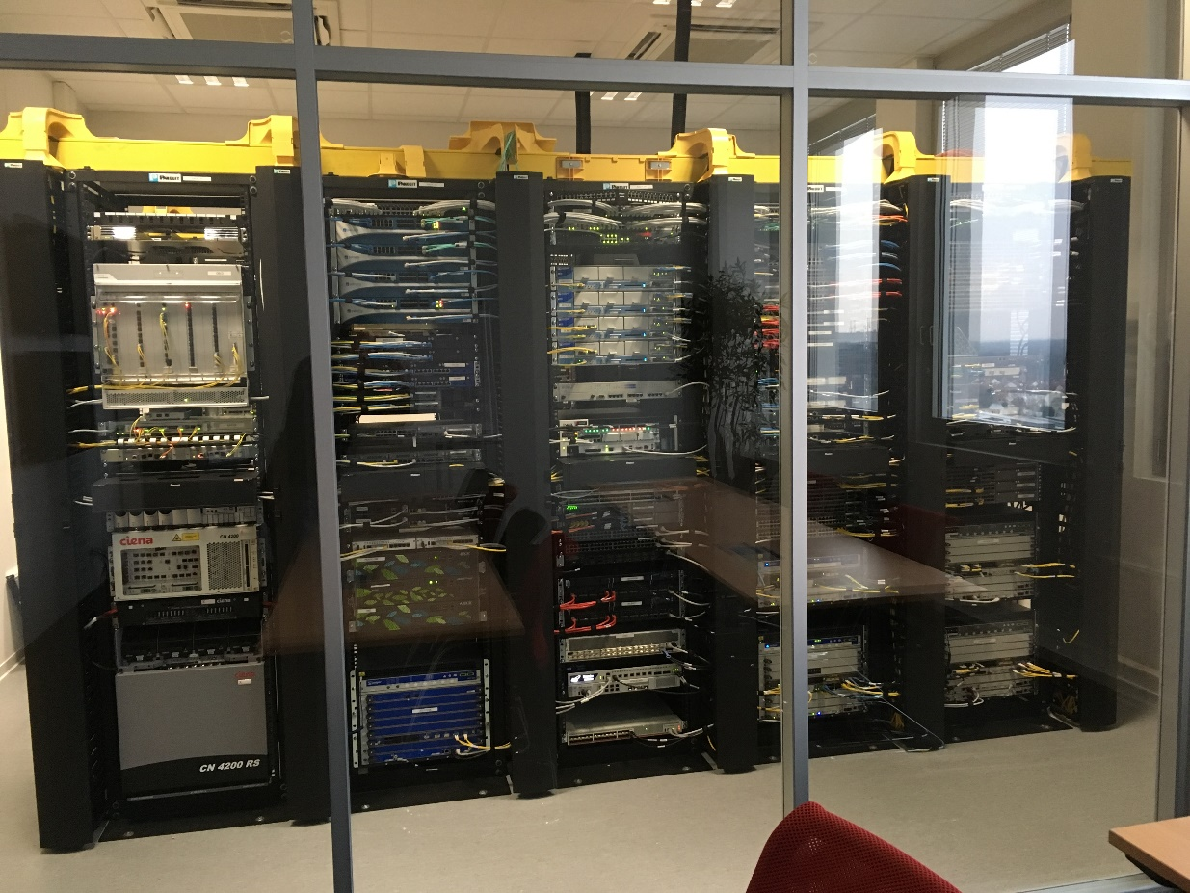
What about the Lab Move?
The Lab moved in July 2016
Besides Physically moving the boxes and cabling everything (according to what Racktables says it should be) there was next to no work needed on order to get the lab back into service
Today all you need to do is adding the device to Racktables
10-20 min later
Shell aliases are ready
DNS is configured
ooB Switches and Fabric are configured
Bookings can be made
Console Port can be accessed

Slide 22
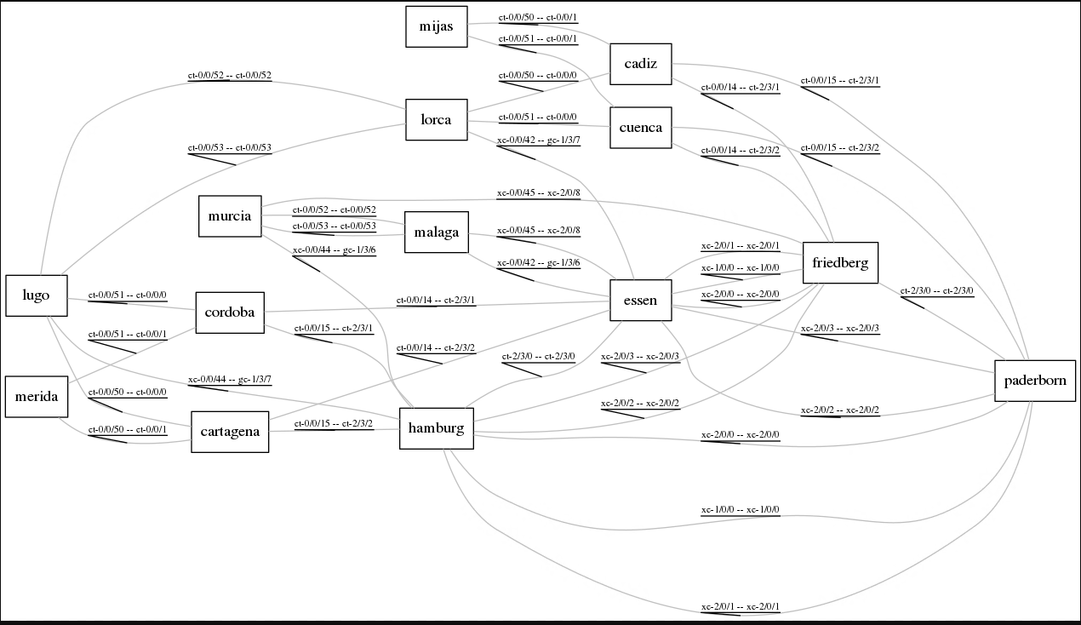
The Future?
Racktables is nice but the lack of an API is …. maybe we will replace Racktables someday
Topology Diagrams
Information is in Racktables anyway
Select Devices of interest and generate nice and shinny Network/Topology Diagram
Prototype with graphviz exists
Trainees are on it to build something nicer
Automation for testing
Existing toolset to deploy virtual testbeds
Extend to physical infrastructure (base configs)
Implement robot framework or similiar

Slide 23
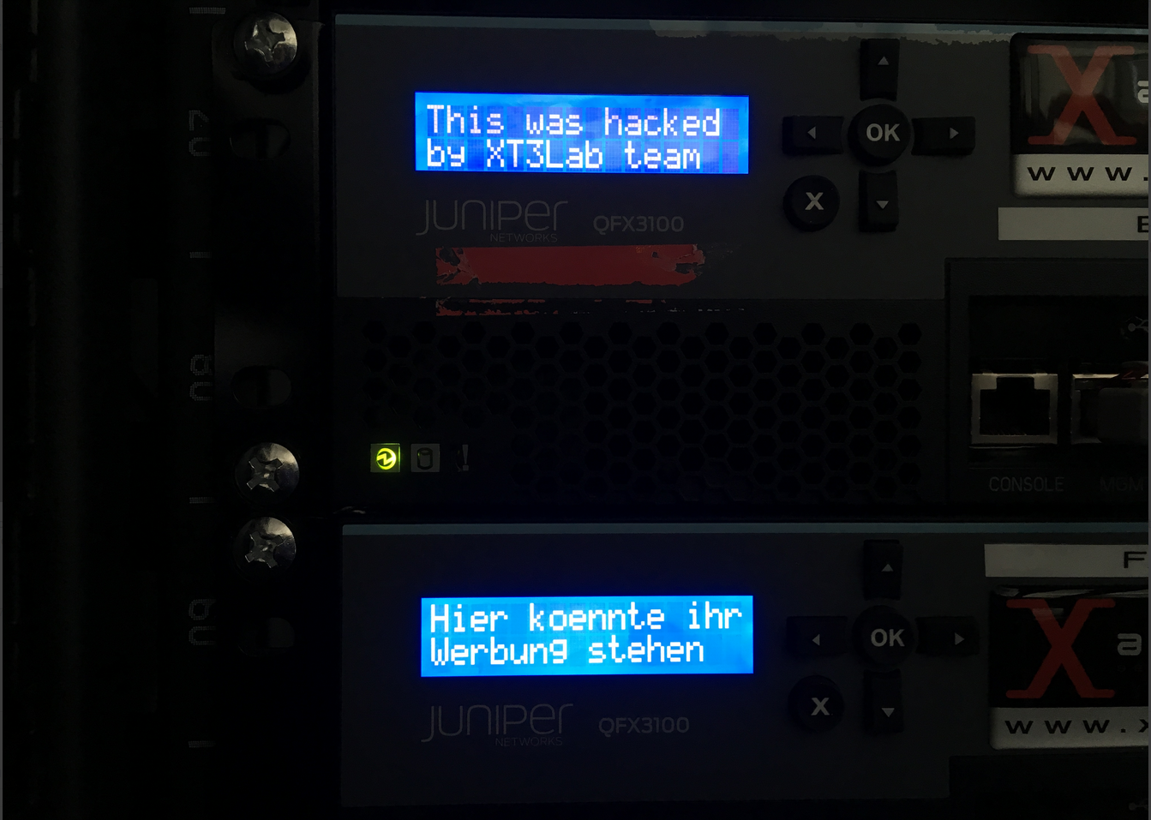
Easteregg 1
Qfabric Director no longer in use
Xeon CPU + 36G Ram
Converted to ESXi Host for Lab Infrastructure
Fancy LCD which still thinks it is Qfabric Director
Not anymore!
Linux VM with serial Port pass-through
LCDproc (Client/Server Architecture)

Slide 24
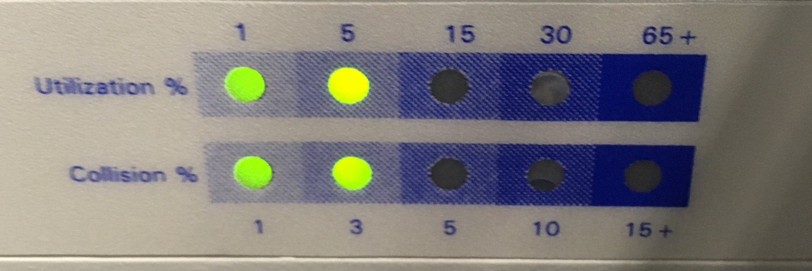
Easteregg 2
Hirschmann Hub found in the Basement
Has a nice collision display LED Matrix (percentage)
We put it into the lab (between 100G IXIA, Juniper MX)
It already raised questions from a couple of visitors
We decided to make it presentable
It now plays a small lightshow

