Slide 1
A Wider Shade of Doh
Peter Koch, DENIC eG DENOG11 Hamburg, 2019-11-12

Slide 2
Resolver @Device

Slide 3
Resolver @CPE

Slide 4
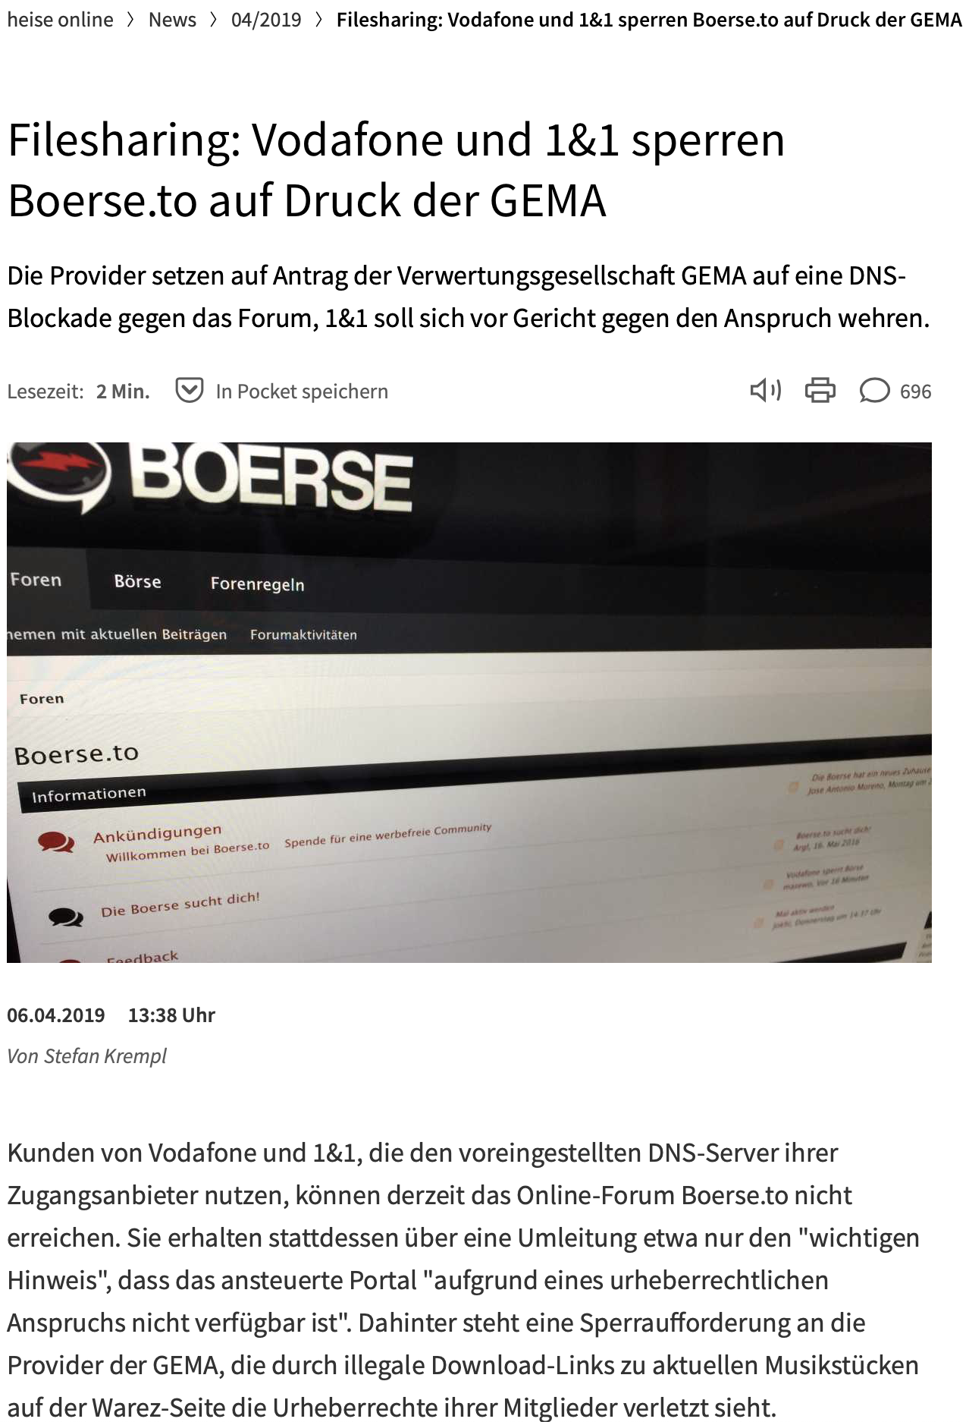
Resolver @ISP
DNS as a content control plane

Slide 5
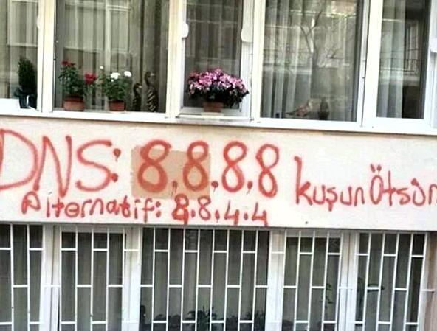
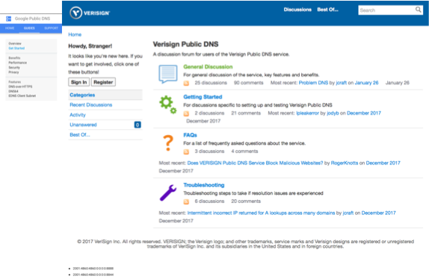
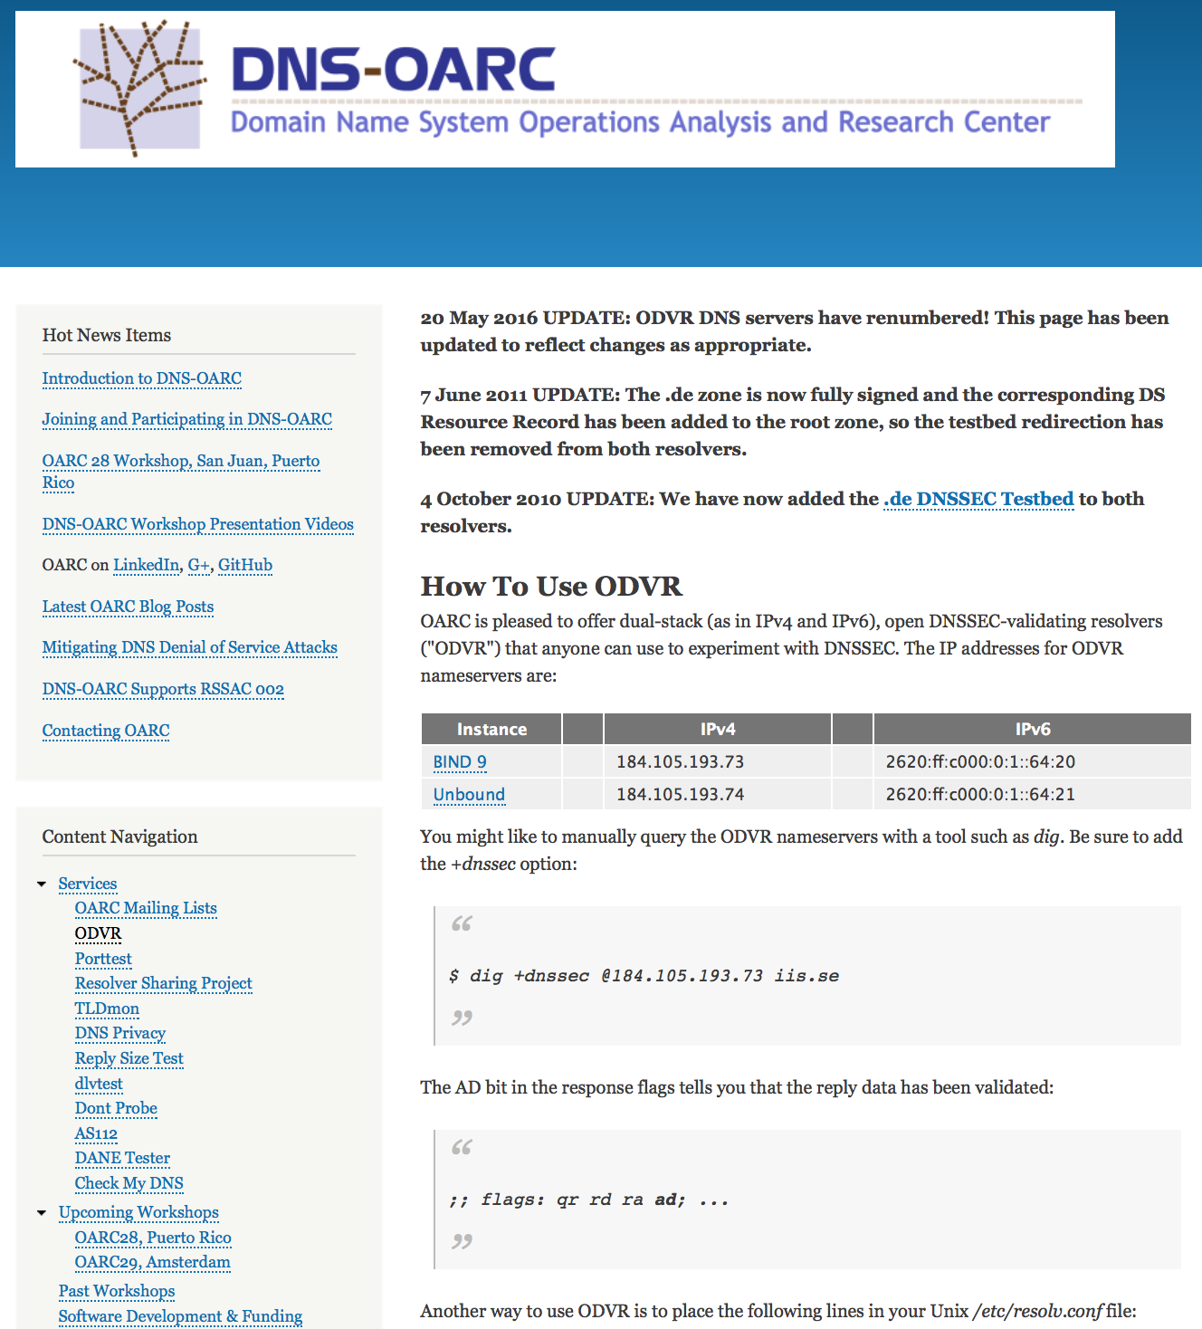
Resolution Services (random selection)
Photo: Twitter @kaansezyum, March 2014

Slide 6
DNS Resolution PATH
CENTR Issue Paper on DNS over HTTPs

Slide 7
Is dns „Public“ data?

Slide 8
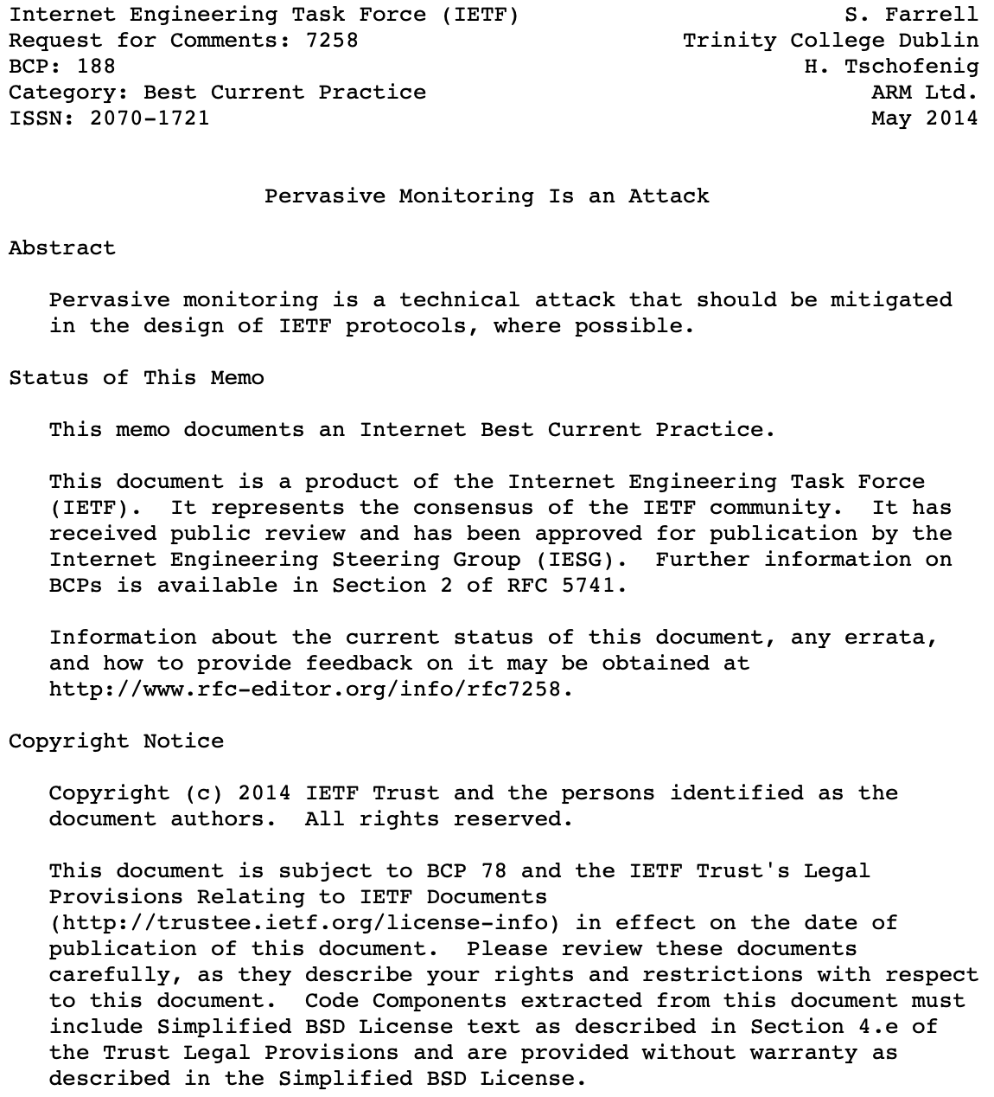
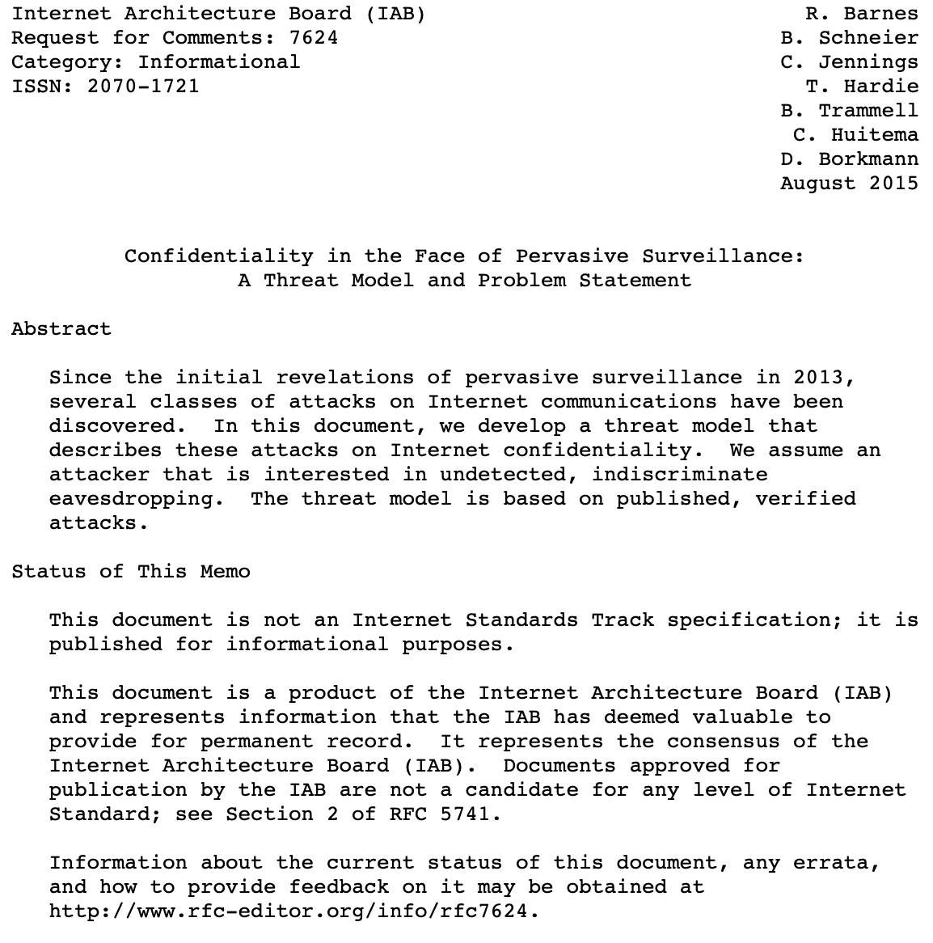
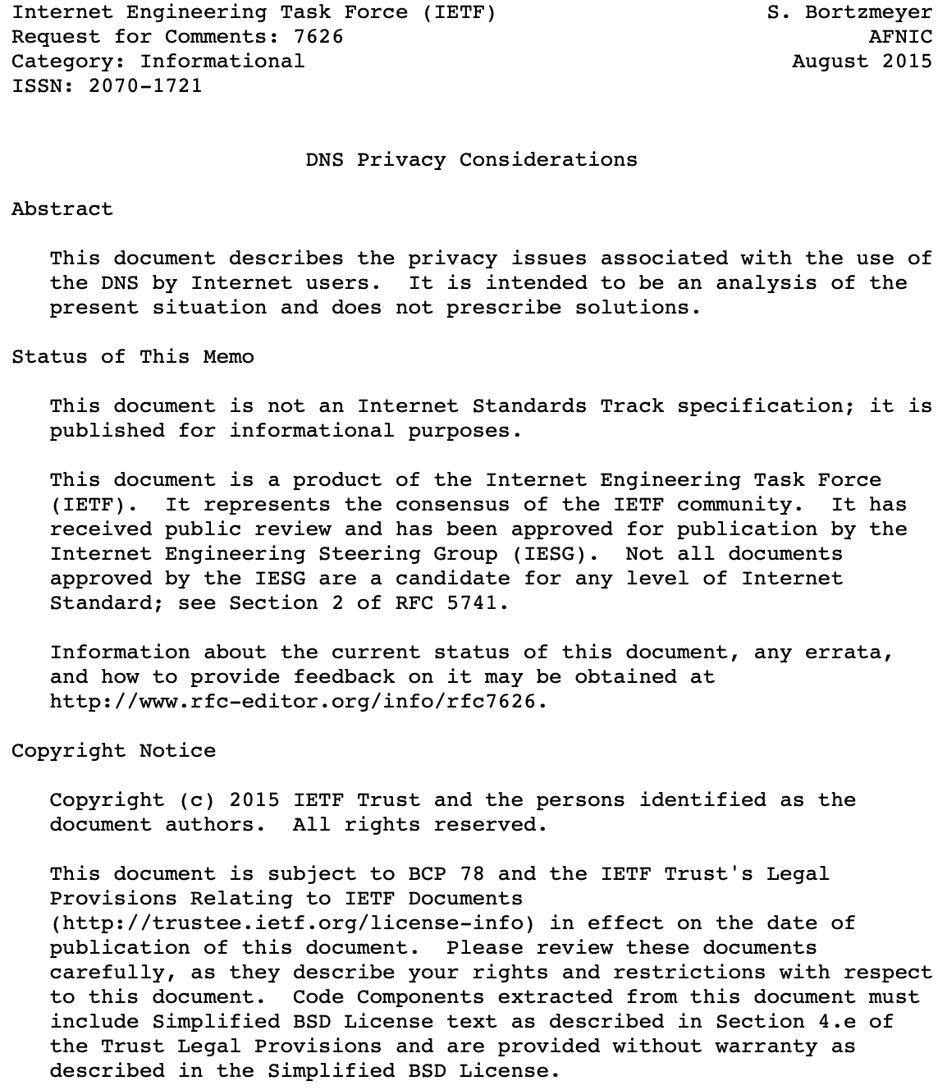
How is dns related to privacy?
https://de.wikipedia.org/wiki/Edward_Snowden#/media/Datei:Edward_Snowden-2.jpg

Slide 9
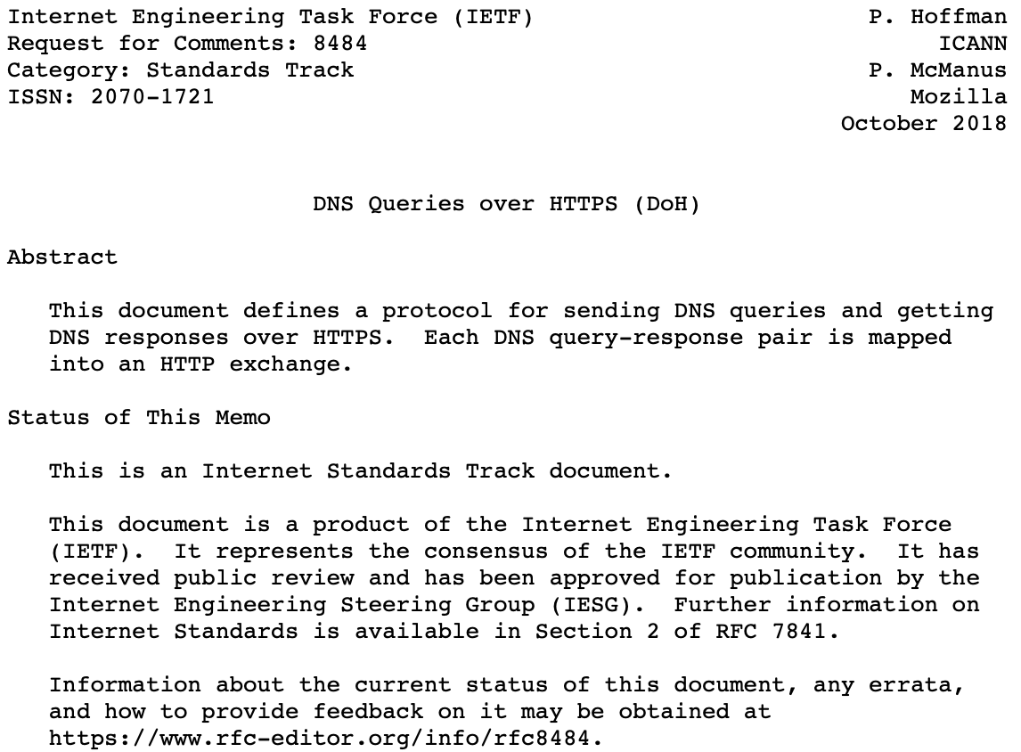
Two approaches developed within the IETF

Slide 10
DNS resolution path -- “DNS over http“ (DOH)
CENTR Issue Paper on DNS over HTTPs

Slide 11
Policy Questions – the bigger picture
DoH does not prescribe a certain Deployment model
… but we can observe development towards concentration/consolidation
DNS name resolution used to be highly decentralized
DNS name resolution as a service appeared prior to DoH
The quads: 1.1.1.1, 8.8.8.8, 9.9.9.9, …
This plus choice of resolution path per application rather than per system/ISP/enterprise → increased concentration (of increasingly large) resolvers

Slide 12
Policy Questions – Resolver privacy
DoH/DoT and others provide privacy (well, confidentiality) on the wire
DNS Resolvers still see users‘ requests
at varying levels of detail
might or might not be able to „identify“ individual
Important: DNS Resolver Policy (what happens to user data?)
Trusted Recursive Resolver (TRR) program (Mozilla)
browser vendor as policy gatekeeper?
not unlike CA/Browser forum ...
Who is to determine which policies are acceptable?

Slide 13
Policy Questions: blocking vs PRIVACY
Mandated DNS Filtering (not nec‘y with user consent)
Increasing list of illegal/harmful/unwanted content
Opt-In Filtering (user consent)
Mostly: malware, ads, …
Something in between
„parental controls“ (also applicable to enterprises)
NXDOMAIN rewriting

Slide 14
Policy Questions – Content Delivery Networks
some scenarios depend on optimizing network traffic by giving different DNS response based on knowledge of users „location“
Not really what the „DNS 101“ says
Proximity no longer a sufficient measure
This brought us EDNS client subnet
Compare that to the information available to a DoH resolver …

Slide 15
Policy Questions – MORE DOH resolvers?
How to avoid an oligopoly?
User choice, really?
How to select „DoH Resolvers“?
Config option might run against initial goal
Regulatory targets might become available even more easily

Slide 16
Policy Questions – the namespace
Assume a group of (cooperating) DoH Resolvers
Further assume a dominant Internet service
A.k.a the Web, as seen by web browsers
… interest in additional name resolution paths?
say, .onion?
Who would be in a position to, practically, open the new paths?
What would that mean for ICANN‘s role w.r.t. the DNS root zone?

Slide 17
MORE Policy Questions – What‘s left?
Everybody talk to everybody?
Compare this to the evolution seen in the email world
Prearrangements between auth and (few) recursives?
Performance?
Of the protocol (UDP vs TCP vs TLS/https)
Of the deployment (higher distance -> latency)
DoH/DoT and DNSSEC are orthogonal
hop-by-hop vs end-2-end
DNSSEC too complicated for marginal additional gain?

Slide 18
DANKE!
FRAGEN?
KONTAKT:
pk@denic.de

